Slide 1
Operating System [BCA 4th-Semester]

Slide 2
OS Structures
2

Slide 3
Topics Covered
User and kernel mode
Operating system structure
System calls
Client-Server Model
Virtual Machines
The Shell

Slide 4
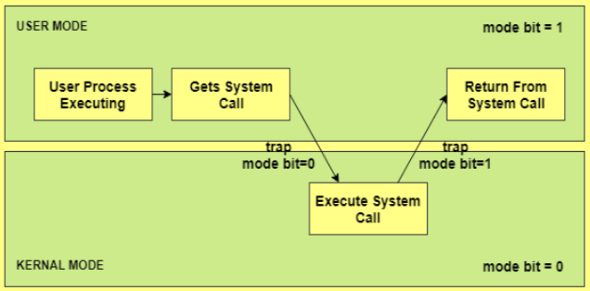
User mode and kernel mode

Slide 5
Operating System Structure
Various ways to structure ones
Simple structure – MS-DOS
More complex -- UNIX
Layered – an abstraction
Microkernel -Mach

Slide 6
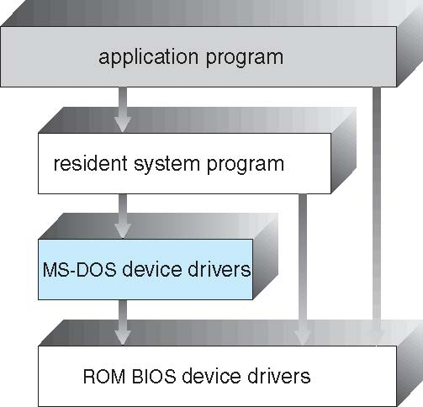
Simple Structure -- MS-DOS
MS-DOS – written to provide the most functionality in the least space
Not divided into modules
Although MS-DOS has some structure, its interfaces and levels of functionality are not well separated .i.e.no CPU execution mode(user and kernel)

Slide 7
Non Simple Structure -- UNIX
UNIX – limited by hardware functionality, the original UNIX operating system had limited structuring. The UNIX OS consists of two separable parts
Systems programs
The kernel
Consists of everything below the system-call interface and above the physical hardware
Provides the file system, CPU scheduling, memory management, and other operating-system functions; a large number of functions for one level

Slide 8
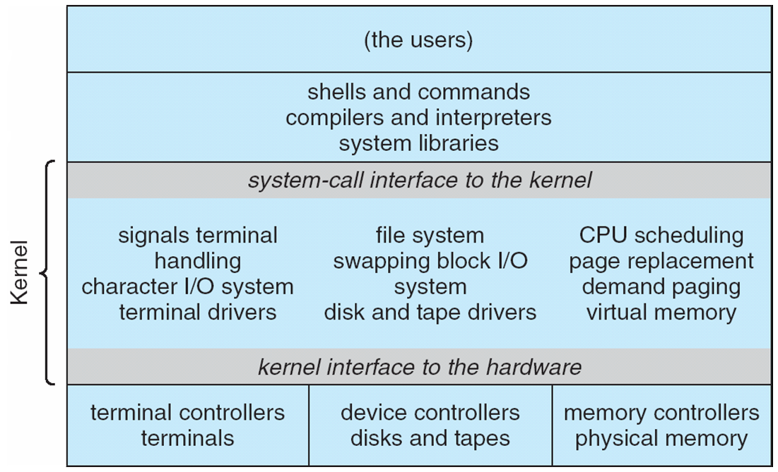
Traditional UNIX System Structure
Beyond simple but not fully layered

Slide 9
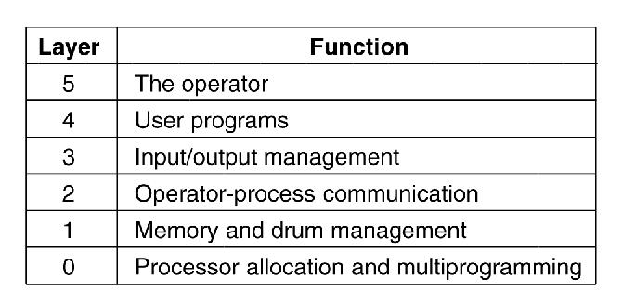
Layered Systems
Figure. Structure of the operating system.
The layering was done by convention, i.e. there was no enforcement by hardware and the entire OS is linked together as one program. This is true of many modern OS systems as well (e.g., linux).

Slide 10
Layer 0 - This layer dealt with allocation of the processor, switching between processes when interrupts occurred or timers expired
Layer 1 - This layer did the memory management
Layer 2 - This layer handled the communication between each process and the operator console
Layer 3 - This layer took care of managing the Input/Output devices and buffering the information streams to and from them
Layer 4 - On this layer, user programs were found
Layer 5 - On this layer, the system operator process was located

Slide 11
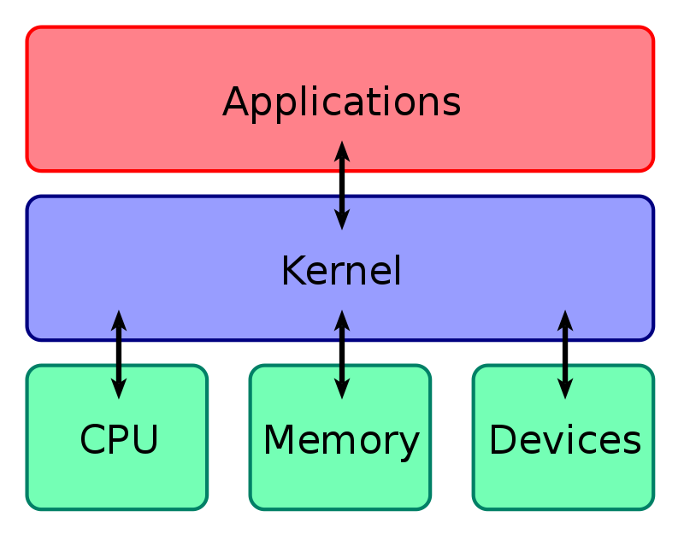
kernel
Kernel is central component of an operating system that manages operations of computer and hardware.
A kernel is the central part of an operating system. It manages the operations of the computer and the hardware, most notably memory and CPU time.

Slide 12
Kernel loads first into memory when an operating system is loaded and remains into memory until operating system is shut down again. It is responsible for various tasks such as disk management, task management, and memory management.
Types of Kernel :
A monolithic kernel
A micro kernel
Hybrid Kernel
Exo Kernel
Nano Kernel

Slide 13
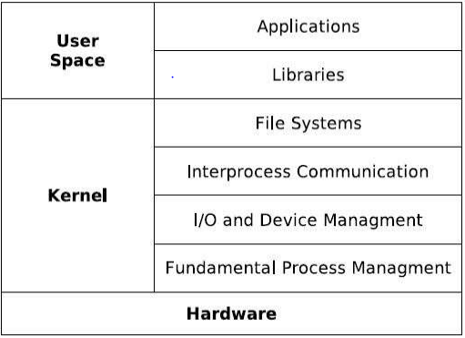
• In monolithic kernel the author tells us that it runs every basic system service in kernel space.
Figure: Monolithic kernel based operating system

Slide 14
Monolithic kernel
The entire O.S. is placed inside the kernel
It runs as a single large process
As all the services are placed inside the kernel, they have a single address space
It is bigger in size
It is easy to implement/code
Performance is high (As kernel can invoke any function directly as everything is placed in the kernel)
Less Secure (If one service fails, entire system crashes)

Slide 15
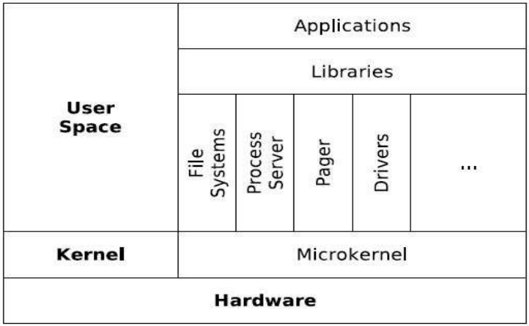
Figure: Micro kernel based operating system

Slide 16
Microkernel System Structure

Slide 17
Microkernel
Only bare minimum code is placed inside the kernel (only basic memory management and Inter Process Communication code) Here the kernel is broken down into processes called as servers
As services(Servers provide services) are separated they have different address spaces -It is smaller in size
It is tough to implement/code
Performance is low (As servers are separated, so to invoke services from other servers IPC(Inter Process Communication) is needed which requires kernel's permission and thus increases access time and lowers the performance)
More Secure (Even if one service crashes, others can function properly because of separation)

Slide 18
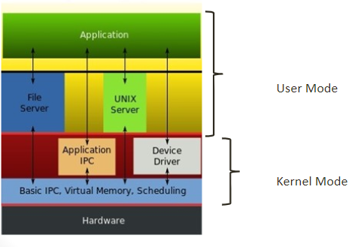
Hybrid Kernel
• A hybrid kernel is a kernel architecture based on combining aspects of microkernel and monolithic kernel architectures used in computer operating systems.
• Example : Mac OS, Microsoft Windows NT kernel that powers all operating systems in the Windows NT family, up to and including Windows 10 and Windows Server 2019, and powers Windows Phone 8, Windows Phone 8.1, and Xbox One.

Slide 19
Exokernel Architecture
In traditional operating systems, systems resources are managed only by
privileged software
kernel
Anybody can manage resources.
Exokernels separate protection
from management.
• Implemented applications are
called library operating systems
(libOSes)

Slide 20
Exokernel Principles
Separate protection and management
Expose allocation
Expose names
Expose revocation
Expose information
Exokernel Architecture
Gives more control to applications through libOSes, such as
User level networking
Application controlled virtual memory
File systems

Slide 21
Traditional operating systems provides only high level
abstractions.
Files
Exokernels allow low level abstractions.
Files
Metadata, Disk blocks, Buffer cache pages
Multiplexing the CPU
Allows a process to save or restore its own registers
Multiplexing Main Memory
Guards memory accesses between competing
Multiplexing the Stable Storage
Provides libOSes with access to stable storage at disk block level

Slide 22
Nanokernel
The term nanokernel ( or for a while they called it picokernel) is used to describe a specific type of kernel.
The nano or pico used to represent a control of the computer clock and the response time (precision timing) to certain process or thread.
Nanokernels are relatively small kernels which provide hardware abstraction, but lack system services. Modern microkernels also lack system services, so the terms have become analogous.
An example of nanokernel is KeyOS that has been used in the System/370, 680x0 and 88x0 processor families since 1983.
An example of nanokernel is KeyOS that has been used in the System/370, 680x0 and 88x0 processor families since 1983

Slide 23
Difference Between Microkernel and Monolithic Kernel
Parameters | Monolithic kernel | MicroKernel
Basic | It is a large process running in a single address space | It can be broken down into separate processes called servers.
Code | In order to write a monolithic kernel, less code is required. | In order to write a microkernel, more code is required
Security | If a service crashes, the whole system collapses in a monolithic kernel. | If a service crashes, it never affects the working of a microkernel.
Communication | It is a single static binary file | Servers communicate through IPC.
Example | Linux, BSDs, Microsoft Windows (95,98, Me), Solaris, OS-9, AIX, DOS, XTS-400, etc. | L4Linux, QNX, SymbianK42, Mac OS X, Integrity, etc.
23

Slide 24
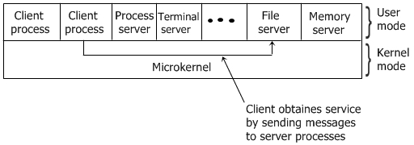
Client-Server Model
In the client-server model, as shown in the figure given below, all the kernel does is handle the communication between the clients and the servers.

Slide 25
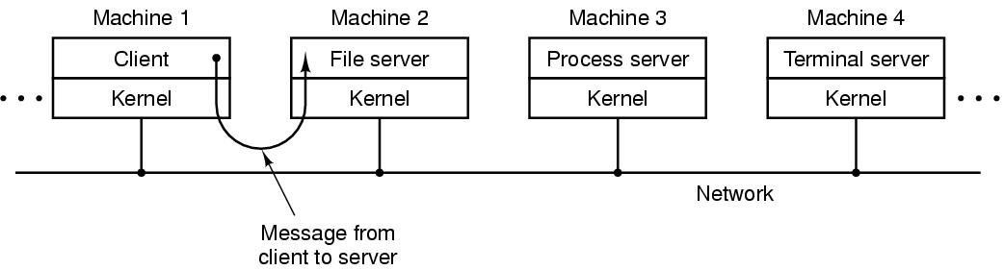
By splitting the operating system (OS) up into parts, each of which only handles one fact of the system, such as file service, terminal service, process service, or memory service, each part becomes small and manageable.
The adaptability of the client-server model, to use in distributed system is the advantage of this model.
Figure . The client-server model over a network.

Slide 26
Virtual Machines
Physical Machine
Application
OS
Hardware
26

Slide 27
Virtual Machines
Virtual Machine 1
Virtual Machine 2
Virtual Machine 3
Application
Application
Application
OS
OS
OS
Virtual Machine Monitor (VMM) (aka Hypervisor)
Hardware
27
Notes:
servers commonly used in their times:
1981: VAX 11/782 minicomputer
1997: a workstation
2014: a rackmount server

Slide 28
Virtual Machines
Virtual machine is an illusion of a real machine. It is created by a real machine operating system, which make a single real machine appears to be several real machine.
The best example of virtual machine architecture is IBM 370 computer.
Vmware, Java virtual machine, .Net framework etc.
Use cases
Resource configuration
Running multiple OSes, either the same or different OSes
Run existing OS binaries on different architecture
28
Notes:
http://www.gsmarena.com/samsung_galaxy_note_3-5665.php

Slide 29
The Shell
The operating system is the code that carries out the system calls.
Editors, compilers, assemblers, linkers, and command interpreters definitely are not part of the operating system, even though they are important and useful.
A Shell provides you with an interface to the Unix system.
It is also the primary interface between a user sitting at his terminal and the operating system

Slide 30
A shell is software that provides an interface between users and operating system of a computer to access the services of a kernel.
There are two types of shell:
Command-line shell (eg. Command Prompt(cmd), C shell, Bourne shell, Korn shell(ksh) etc.)
GUI Shell (eg. Windows Explorer or Windows Shell )

Slide 31
System Calls
Programming interface to the services provided by the OS.
A system call is a mechanism that provides the interface between a process and the operating system.
Implementation language
–Typically written in a high-level language (C or C++)
–Certain low-level tasks (direct hardware access) are written using assembly language
Example of using system call
–Read data from a file and copy to another file
–open()+ read() + write()?

Slide 32
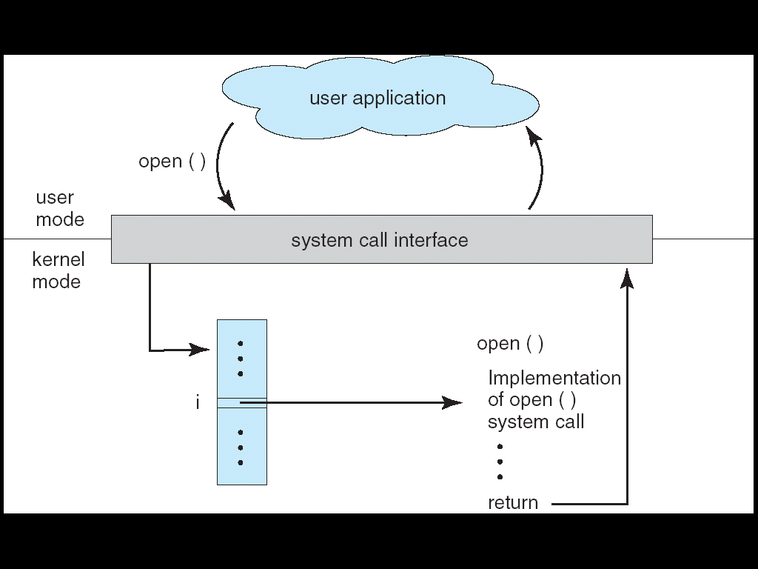
System Calls
Interface between applications and the OS.
Application uses an assembly instruction to trap into the kernel
Some higher level languages provide wrappers for system calls (e.g., C)oy tables or stack.
Linux has about 300 system calls
read(), write(), open(), close(), fork(), exec(), ioctl(),…..
32

Slide 33
Implementation Benefits
• The caller needs to know nothing about
–how the system call is implemented
–what it does during execution
–Just needs to obey API and understand what OS will do as a result call
Most details of OS interface are hidden from programmer by API
–Managed by run-time support library

Slide 34
Types of System calls
Here are the five types of system calls used in OS:
Process Control
File Management
Device Management
Information Maintenance
Communications

Slide 35
Process control
This system calls perform the task of process creation, process termination, etc. Functions:
end, abort
load, execute
get process attributes, set process attributes
wait for time
wait event, signal event
allocate and free memory
Dump memory if error
Debugger for determining bugs, single step execution
Locks for managing access to shared data between processes

Slide 36
File management
File management system calls handle file manipulation jobs like creating a file, reading, and writing, etc.
Functions: -open, close file -read, write, reposition -get and set file attributes
Device management
Device management does the job of device manipulation like reading from device buffers, writing into device buffers, etc.
Functions: request device, release device -read, write, reposition
get device attributes, set device attributes
logically attach or detach devices

Slide 37
Information maintenance
It handles information (you can call metadata also) and its transfer between the OS and the user programs.
Functions: -get time or date, set time or date -get system data, set system data -get and set process, file, or device attributes
Communications
create, delete communications connections
send, receive messages if message passing model to host name or process name
From client to server
Shared-memory model create and gain access to memory regions
transfer status information
attach and detach remote devices

Slide 38
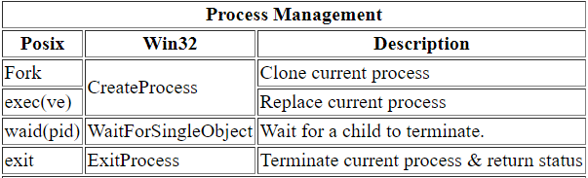
A Few Important Posix/Unix/Linux and Win32 System Calls
System Calls Process Management

Slide 39
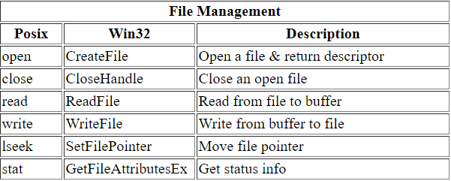
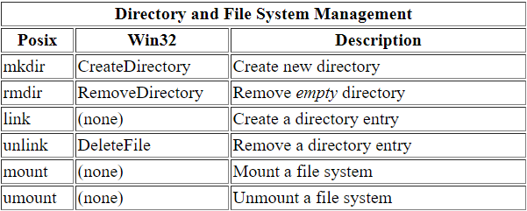
System Calls for File Management
System Calls for Directory Management

Slide 40
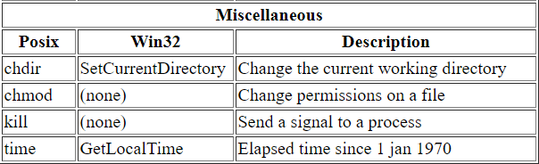
Examples of Miscellaneous System Calls

Slide 41
Thank you

